Slide 1
Flying flamingos
WANG Qianwen
LIU Suyun

Slide 2
Content
Available parts
Overall structures
Terrain design
Light setting
Mesh manipulation
User Interaction

Slide 3
Available parts
Flamingo geometry (flamingo.js)
Vertices and faces
morph targets for animation: 14 status during its flying
Method: THREE.AnimationClip.CreateFromMorphTargetSequence(name, morphTargetSequence, fps)
(https://threejs.org/examples/#webgl_lights_hemisphere)

Slide 4
Overall structures
3 pairs of fragment and vertex shaders
Initialized scene: camera, light, background texture, mesh loader and render setting
Animated scene: Light position, mesh position and texture, camera position

Slide 5
Terrain design
Ball space
Create double-side texture by vertexShader and fragmentShader
(some modification on its texture)
Ground sea and island
(sea amination is needed especially when camera stops)
Height map simulate terrains
vertexShader3 and fragmentShader3

Slide 6
Light setting
Ambient Light
White color with lower density (night) and higher density (day)
Direct Light in the night
Density increases gradually to certain value
Position change over the flamingo’s position
Direct light in the day
Simulate the Sun with constant high density
Keep stationary on the sky

Slide 7
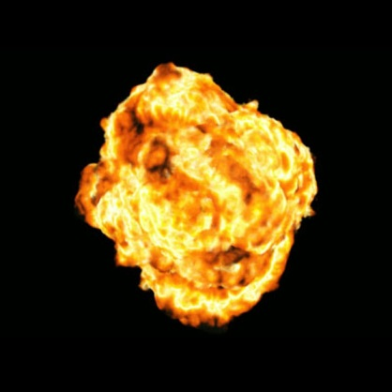
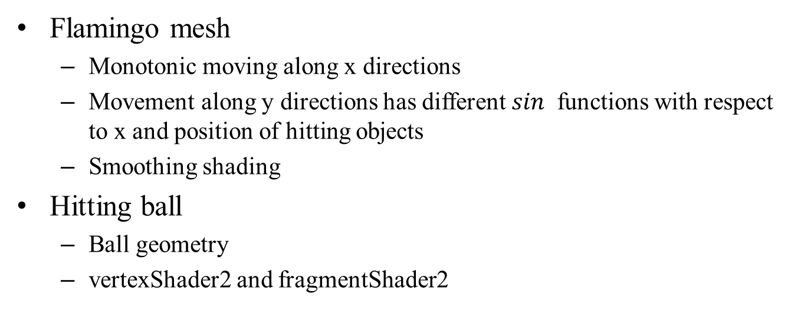
Mesh manipulation
Flamingo mesh
Monotonic moving along x directions
Movement along y directions has different $sin⁡$ functions with respect to x and position of hitting objects
Smoothing shading
Hitting ball
Ball geometry
vertexShader2 and fragmentShader2

Slide 8
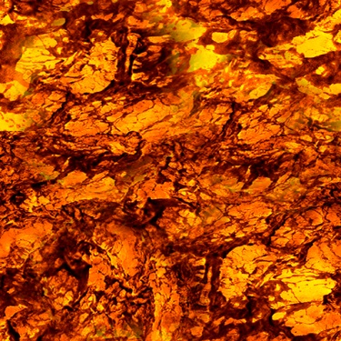
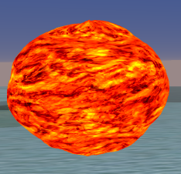
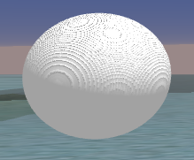
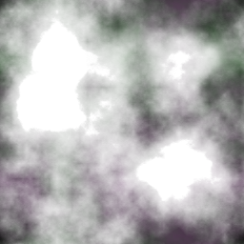
Mesh manipulation
Hitting ball
Noise and bump

Slide 9
User Interaction
Keyboard
0: stop or continue any movement;
1: move along positive x (right);
2: move along negative x (left, by default);
3: move along positive y (down);
4: move along negative y (up);
5: move along positive z (farther);
6: move along negative z (nearer);

